Slide 1
Mega Project Idea Presentation
A33 Kaushik Walwadkar
A34 Prathamesh Chavan
A35 Akshata Kulkarni
A59 Piyusha Patil

Slide 2

Drivers Adda
The platforms like Uber, Ola just give facility to hire a cab.
To develop the web application to hire the drivers on rent.
Web Technology and Database System.
It can be used by Enterprises to hire a drivers on contract basis.

Slide 3
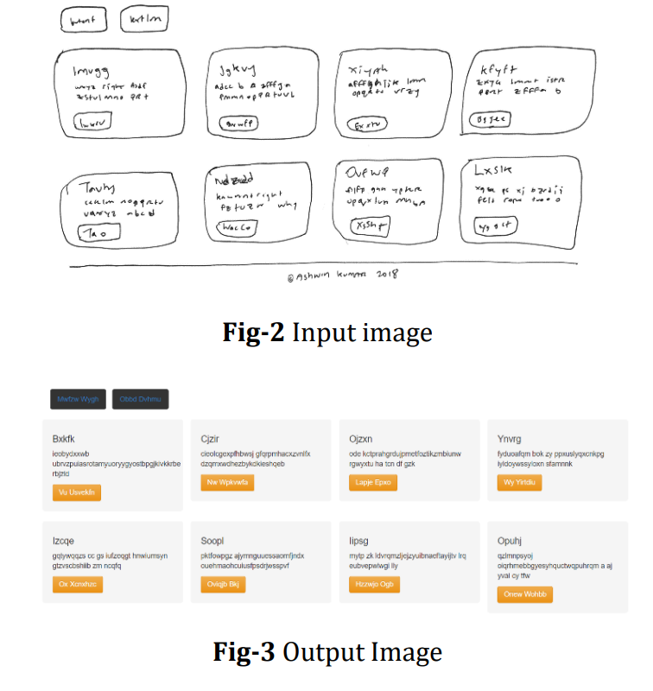
HTML Code Generation from Mock-up Images using Machine Learning Techniques
Abstract Idea of Project
Machine Learning techniques used
Proposed Plan
- Workflow

